Slide 1
DITAP
Iteration 2B
Digital Services in the 21st Century Government

Slide 2
Communication:
Responsible communications with vendors

Slide 3
Pre-solicitation communications
The Federal government spends over $500 billion each year on goods and services; you have an obligation to complete every procurement you’re involved in as effectively, efficiently, and responsibly as possible.
Pre-solicitation communication with vendors is recommended in order to access current information and define requirements properly. Ideally, it should begin well before the issuing of a solicitation.
Notes:
There are two goals or purposes to this interaction.
First, the government hopes to improve their end results by obtaining as much information and knowledge as possible regarding possibilities from vendors prior to preparing a solicitation.
Secondly, the government wants to know how to better communicate and increase vendor understanding of the need, in the hopes that they will receive better informed offers.
While the FAR allows for a good deal of flexibility in establishing pre-solicitation communication with potential vendors, some agencies are reluctant to exercise all of their options. They fear stepping over the line and drawing protests or potentially compromising procurement integrity. Vendors may also be reluctant to discuss requirements and solutions in the presence of potential competitors and may fear that talking privately to an agency could limit their future opportunities. However, especially in the world of digital services procurement, open pre-solicitation communication with potential vendors is critical. Why is that the case? And how do you execute it effectively? You’ll learn the answers to these questions by completing this online learning.

Slide 4
Acquisition process myths
To alleviate some of these concerns and encourage agencies to pursue all legitimate avenues of communication, the Office of Federal Procurement Policy (OFPP) held a series of meetings and developed two memoranda addressing 10 government and eight vendor “myths” regarding the acquisition process.
Many of the myths deal with responsible pre-solicitation (the focus of this module), but there are others that apply to other phases in the acquisition lifecycle.

Slide 5
Myths:
Government

Slide 6
Acquisition process myths
A. Government officials can generally meet one-on-one with potential offerors as long as no vendor receives preferential treatment.
false
B. We can’t meet one-on-one with a potential offeror.
false
C. Government officials can generally meet one-on-one with potential offerors as long as vendors do not disclose preferential treatment received.

Slide 7
Acquisition process myths
false
A. A protest is something to be avoided at all costs - even if it means the government limits conversations with industry.
false
B. Protests can’t be avoided.
C. Restricting communication won’t prevent a protest, and limiting communication might actually increase the chance of a protest – in addition to depriving the government of potentially useful information.

Slide 8
Acquisition process myths
false
A. Conducting discussions/negotiations after receipt of proposals will add too much time to the schedule.
B. Whether discussions should be conducted is a key decision for contracting officers to make. Avoiding discussions solely because of schedule concerns may be counter-productive, and may cause delays and other problems during contract performance.
C. Discussions should only be had via official mediums such as to avoid any protests, consider also limiting them to specific timeframes.
false

Slide 9
Acquisition process myths
false
A. When the government awards a task or delivery order using the Federal Supply Schedules, debriefing the offerors isn’t required so it shouldn’t be done.
false
B. Debriefing offerors is optional, it comes down to timing on the government side whether debriefing is done or not.
C. Providing feedback is important, both for offerors and the government, so agencies should generally provide feedback whenever possible.

Slide 10
Acquisition process myths
false
A. Industry days and similar events attended by multiple vendors are of low value to industry and the government because industry won’t provide useful information in front of competitors, and the government doesn’t release new information.
B. Well-organized industry days, as well as pre-solicitation and pre-proposal conferences, are valuable opportunities for the government and for potential vendors – both prime contractors and subcontractors, many of whom are small businesses.
C. Consider non-traditional approaches to industry days - bringing in the draft RFQ and workshopping the evaluation criteria with the participants of the industry day is a great way to get feedback on the solicitation process and doesn’t violate procurement rules. Then the bidding pool will be much more interested in participating if they help craft how it will be evaluated.

Slide 11
Acquisition process myths
A. The technical requirements are only part of the acquisition; getting feedback on terms and conditions, pricing structure, performance metrics, evaluation criteria, and contract administration matters will improve the award and implementation process.
B. The program manager already talked to industry to develop the technical requirements, so the contracting officer doesn’t need to do anything else before issuing the RFP.
false
C. Certified DS Expert knows enough about the market and the conditions of the services/supplies desired to be a valuable part of that conversation and should be included

Slide 12
Acquisition process myths
A. Giving industry only a few days to respond to an RFP is OK since the government has been talking to industry about this procurement for over a year.
false
B. Even if there is a short turn-around time the government should be open about the conditions of WHY that is and that they are really searching for a good offeror.
C. Providing only short response times may result in the government receiving fewer proposals and the ones received may not be as well-developed - which can lead to a flawed contract. This approach signals that the government isn’t really interested in competition.

Slide 13
Acquisition process myths
A. The government loses when we limit ourselves to the companies we already work with. Instead, we need to look for opportunities to increase competition and ensure that all vendors, including small businesses, get fair consideration.
false
B. Getting broad participation by many different vendors is too difficult; we’re better off dealing with the established companies we know.
C. By using different source selection techniques - such as code challenges, design challenges and other methods vs. the traditional paperbased RFQ process - broad participation by non-traditional sources is encourgaged - a non-government company might be way more interested in a code challenge than writing a 30 page PWS.

Slide 14
Myths:
Vendors

Slide 15
Acquisition process myths
A. Contracting officers and program managers are often inundated with general marketing material that doesn’t reach the right people at the right time. As an alternative, vendors can take advantage of the various outreach sessions that agencies hold for the purpose of connecting contracting officers and program managers with companies whose skills are needed.
B. The best way to present my company’s capabilities is by marketing directly to contracting officers and/or signing them up for my mailing list.”
false
false
B. The best way to get on contracting officer’s radars is by becoming friends with them, taking them out to eat and just making sure they know who I am.

Slide 16
Acquisition process myths
A. In meetings with government technical personnel, it’s far more valuable for you to bring subject matter experts to the meeting rather than focusing on the sales pitch.
false
B. It is a good idea to bring only business development and marketing people to meetings with the agency’s technical staff.
false
C. You should always bring lawyers to meetings with government technical personnel.

Slide 17
Acquisition process myths
false
A. Attending industry days and outreach events is not valuable because the agency doesn’t provide new information.
B. Industry days and outreach events can be a valuable source of information for potential vendors and are increasingly being used to leverage scarce staff resources.
false
C. Industry days and outreach events are very expensive for non-traditionals and only large businesses attend.

Slide 18
Acquisition process myths
false
A. Agencies generally have already determined their requirements and acquisition approach so our impact during the pre-RFP phase is limited.
B. Early and specific industry input is valuable. Agencies generally spend a great deal of effort collecting and analyzing information about capabilities within the marketplace. The more specific you can be about what works, what doesn’t, and how it can be improved, the better.
false
C. No planning is needed in an agile project. Don’t ask industry, just get an RFP out there.

Slide 19
Acquisition process myths
A. Agency personnel have a responsibility to protect proprietary information from disclosure outside the government and will not share it with other companies.
false
B. If I meet one-on-one with agency personnel, they may share my proprietary data with my competition.”
C. Agencies don’t need to worry about what data we share. We always have government purposes rights. It is up to the vendor to protect their data.
false

Slide 20
Acquisition process myths
A. Agencies may not share information about contracts with other agencies, if the vendor prohibits them from doing so.
B. Agencies have an obligation not to share information about their contracts, such as prices, with other agencies, similar to the obligation they have not to disclose proprietary information to the public.
false
false
C. There are no general limitations on the disclosure of information regarding existing contracts between agencies within the government. In fact, agencies are encouraged to share pricing information to ensure that we are getting the best value for our taxpayers.

Slide 21
Acquisition process myths
A. To develop my new proposal, I don’t really need to tailor my solution to the specific solicitation since the government won’t read my proposal that closely anyway.
false
B. Offerors should tailor each proposal to the evaluation criteria, proposal instructions, and specific requirements of the solicitation to which they are responding. Contracting officers and evaluation team members read proposals closely for compliance with the proposal instructions and must evaluate them against the evaluation factors and the statement of work in the solicitation.
C. An RFP should include as much detail and requirements specification as possible in order to avoid protests later.
false

Slide 22
Acquisition process myths
false
A. If I lose the competition, I shouldn’t bother to ask for a debriefing.
B. Unsuccessful offerors should ask for a debriefing to understand the award decision and to improve future proposals.
false
C. Losing vendors will always be kind, caring and understanding

Slide 23
Why it matters:
Pre-solicitation communication

Slide 24
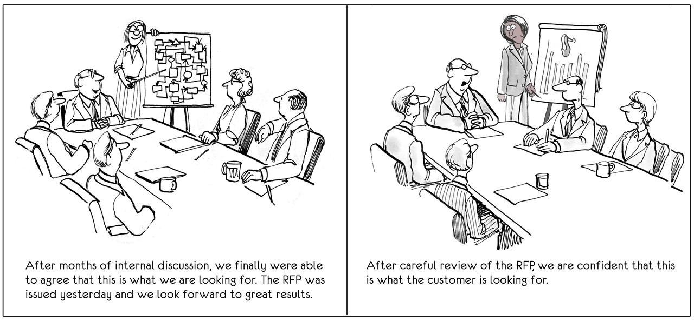
Why Pre-Solicitation Communication Matters
Notes:
Now that we’ve established that it’s permissible to engage in pre-solicitation communication with potential vendors and end-users, let’s take a look at why you should do so.
As shown in the cartoon, the government may issue a solicitation that seems extremely clear to them, only to have vendors interpret it differently when it “hits the street.” This is the situation illustrated in the above cartoon. To avoid situations like the one in the cartoon and keeping the lines of communication open between government and industry during the pre-solicitation phase, you will wind up with:
Better requirements
Better bids
Increased interoperability through shared standards
Let’s look at each of these.

Slide 25
Why Pre-Solicitation Communication Matters
To avoid situations like the one in the cartoon and keeping the lines of communication open between government and industry during the pre-solicitation phase, you will wind up with:
  Better requirements
  Better bids
  Increased interoperability through shared standards

Slide 26
Toolkit:
Market Research

Slide 27
Market Research
The action or activity of gathering information about an industry and market. It defines the what is needed for business success.
Notes:
In order to acquire the best digital service solutions they can afford, agencies need to have a clear understanding of what the market can provide. Appropriate communication with potential vendors is key to gaining this understanding.
In this module, we have shown that pre-solicitation communication with vendors is not only allowed, but desirable, and that there are many different ways to effectively engage with offerors.
To motivate and encourage agencies to continually assess and improve their vendor engagement practices, OMB has outlined specific steps for obtaining and utilizing feedback from both their own employees and industry regarding the acquisition process. As you read, ask yourself what you can do as an individual acquisition professional to improve the pre-solicitation communication in your agency.
Finally, join in on the discussion below by responding to the following question:
How do you see pre-solicitation communication as being important to the acquisition of digital services? Provide an example, if you can, of a situation in which communicating with vendors prior to solicitation made a significant difference in the outcome.

Slide 28
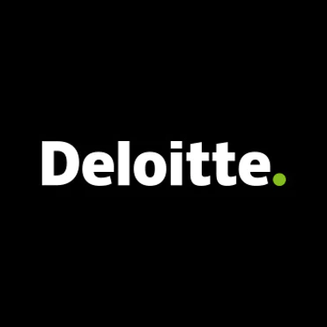






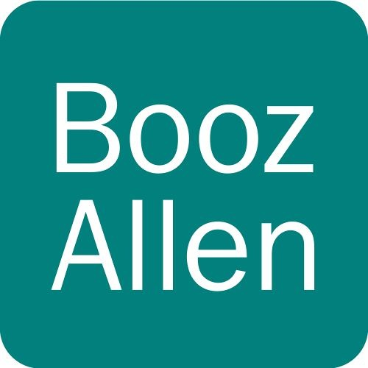
Market Research- Examples of the agile professional services space
Large Consultancies
Mid-size Consultancies
Small Consultancy
Notes:
In order to acquire the best digital service solutions they can afford, agencies need to have a clear understanding of what the market can provide. Appropriate communication with potential vendors is key to gaining this understanding.
In this module, we have shown that pre-solicitation communication with vendors is not only allowed, but desirable, and that there are many different ways to effectively engage with offerors.
To motivate and encourage agencies to continually assess and improve their vendor engagement practices, OMB has outlined specific steps for obtaining and utilizing feedback from both their own employees and industry regarding the acquisition process. As you read, ask yourself what you can do as an individual acquisition professional to improve the pre-solicitation communication in your agency.
Finally, join in on the discussion below by responding to the following question:
How do you see pre-solicitation communication as being important to the acquisition of digital services? Provide an example, if you can, of a situation in which communicating with vendors prior to solicitation made a significant difference in the outcome.

Slide 29
Market Research
In your situation it is often the case that those in your field of view are always the same players.
Notes:
In order to acquire the best digital service solutions they can afford, agencies need to have a clear understanding of what the market can provide. Appropriate communication with potential vendors is key to gaining this understanding.
In this module, we have shown that pre-solicitation communication with vendors is not only allowed, but desirable, and that there are many different ways to effectively engage with offerors.
To motivate and encourage agencies to continually assess and improve their vendor engagement practices, OMB has outlined specific steps for obtaining and utilizing feedback from both their own employees and industry regarding the acquisition process. As you read, ask yourself what you can do as an individual acquisition professional to improve the pre-solicitation communication in your agency.
Finally, join in on the discussion below by responding to the following question:
How do you see pre-solicitation communication as being important to the acquisition of digital services? Provide an example, if you can, of a situation in which communicating with vendors prior to solicitation made a significant difference in the outcome.

Slide 30
Market Research
Why do you think that this is the case?
Notes:
In order to acquire the best digital service solutions they can afford, agencies need to have a clear understanding of what the market can provide. Appropriate communication with potential vendors is key to gaining this understanding.
In this module, we have shown that pre-solicitation communication with vendors is not only allowed, but desirable, and that there are many different ways to effectively engage with offerors.
To motivate and encourage agencies to continually assess and improve their vendor engagement practices, OMB has outlined specific steps for obtaining and utilizing feedback from both their own employees and industry regarding the acquisition process. As you read, ask yourself what you can do as an individual acquisition professional to improve the pre-solicitation communication in your agency.
Finally, join in on the discussion below by responding to the following question:
How do you see pre-solicitation communication as being important to the acquisition of digital services? Provide an example, if you can, of a situation in which communicating with vendors prior to solicitation made a significant difference in the outcome.

Slide 31
Market Research
Why do you think that this is the case?
It is because often these companies have shops dedicated to seeking out government agencies and establishing relationships with contracting shops.
Notes:
In order to acquire the best digital service solutions they can afford, agencies need to have a clear understanding of what the market can provide. Appropriate communication with potential vendors is key to gaining this understanding.
In this module, we have shown that pre-solicitation communication with vendors is not only allowed, but desirable, and that there are many different ways to effectively engage with offerors.
To motivate and encourage agencies to continually assess and improve their vendor engagement practices, OMB has outlined specific steps for obtaining and utilizing feedback from both their own employees and industry regarding the acquisition process. As you read, ask yourself what you can do as an individual acquisition professional to improve the pre-solicitation communication in your agency.
Finally, join in on the discussion below by responding to the following question:
How do you see pre-solicitation communication as being important to the acquisition of digital services? Provide an example, if you can, of a situation in which communicating with vendors prior to solicitation made a significant difference in the outcome.

Slide 32
Market Research
In order to find non-traditionals, you need to be non-traditional in your own approach.
Notes:
In order to acquire the best digital service solutions they can afford, agencies need to have a clear understanding of what the market can provide. Appropriate communication with potential vendors is key to gaining this understanding.
In this module, we have shown that pre-solicitation communication with vendors is not only allowed, but desirable, and that there are many different ways to effectively engage with offerors.
To motivate and encourage agencies to continually assess and improve their vendor engagement practices, OMB has outlined specific steps for obtaining and utilizing feedback from both their own employees and industry regarding the acquisition process. As you read, ask yourself what you can do as an individual acquisition professional to improve the pre-solicitation communication in your agency.
Finally, join in on the discussion below by responding to the following question:
How do you see pre-solicitation communication as being important to the acquisition of digital services? Provide an example, if you can, of a situation in which communicating with vendors prior to solicitation made a significant difference in the outcome.

Slide 33
Market Research
You already try to do some of this;
Reverse industry days
1:1 sessions
Draft RFPs
...
Notes:
In order to acquire the best digital service solutions they can afford, agencies need to have a clear understanding of what the market can provide. Appropriate communication with potential vendors is key to gaining this understanding.
In this module, we have shown that pre-solicitation communication with vendors is not only allowed, but desirable, and that there are many different ways to effectively engage with offerors.
To motivate and encourage agencies to continually assess and improve their vendor engagement practices, OMB has outlined specific steps for obtaining and utilizing feedback from both their own employees and industry regarding the acquisition process. As you read, ask yourself what you can do as an individual acquisition professional to improve the pre-solicitation communication in your agency.
Finally, join in on the discussion below by responding to the following question:
How do you see pre-solicitation communication as being important to the acquisition of digital services? Provide an example, if you can, of a situation in which communicating with vendors prior to solicitation made a significant difference in the outcome.

Slide 34
Market Research
But how else can you uncover non-traditionals to help populate your market research and add to your toolkit?
Notes:
In order to acquire the best digital service solutions they can afford, agencies need to have a clear understanding of what the market can provide. Appropriate communication with potential vendors is key to gaining this understanding.
In this module, we have shown that pre-solicitation communication with vendors is not only allowed, but desirable, and that there are many different ways to effectively engage with offerors.
To motivate and encourage agencies to continually assess and improve their vendor engagement practices, OMB has outlined specific steps for obtaining and utilizing feedback from both their own employees and industry regarding the acquisition process. As you read, ask yourself what you can do as an individual acquisition professional to improve the pre-solicitation communication in your agency.
Finally, join in on the discussion below by responding to the following question:
How do you see pre-solicitation communication as being important to the acquisition of digital services? Provide an example, if you can, of a situation in which communicating with vendors prior to solicitation made a significant difference in the outcome.

Slide 35
Market Research
You are part of a small team that has been tasked with identifying non-traditionals to bid on a new emerging market product for USCIS to help in achieving E-Filing 2020...
Notes:
In order to acquire the best digital service solutions they can afford, agencies need to have a clear understanding of what the market can provide. Appropriate communication with potential vendors is key to gaining this understanding.
In this module, we have shown that pre-solicitation communication with vendors is not only allowed, but desirable, and that there are many different ways to effectively engage with offerors.
To motivate and encourage agencies to continually assess and improve their vendor engagement practices, OMB has outlined specific steps for obtaining and utilizing feedback from both their own employees and industry regarding the acquisition process. As you read, ask yourself what you can do as an individual acquisition professional to improve the pre-solicitation communication in your agency.
Finally, join in on the discussion below by responding to the following question:
How do you see pre-solicitation communication as being important to the acquisition of digital services? Provide an example, if you can, of a situation in which communicating with vendors prior to solicitation made a significant difference in the outcome.

Slide 36
Market Research
How do you:
identify non-traditionals?
attract non-traditionals?
help non-traditionals bid on your projects?
reduce entry-points for non-traditionals?
ensure that you get the right talent?
get the right people to come to you?
get referrals?
Notes:
In order to acquire the best digital service solutions they can afford, agencies need to have a clear understanding of what the market can provide. Appropriate communication with potential vendors is key to gaining this understanding.
In this module, we have shown that pre-solicitation communication with vendors is not only allowed, but desirable, and that there are many different ways to effectively engage with offerors.
To motivate and encourage agencies to continually assess and improve their vendor engagement practices, OMB has outlined specific steps for obtaining and utilizing feedback from both their own employees and industry regarding the acquisition process. As you read, ask yourself what you can do as an individual acquisition professional to improve the pre-solicitation communication in your agency.
Finally, join in on the discussion below by responding to the following question:
How do you see pre-solicitation communication as being important to the acquisition of digital services? Provide an example, if you can, of a situation in which communicating with vendors prior to solicitation made a significant difference in the outcome.

Slide 37
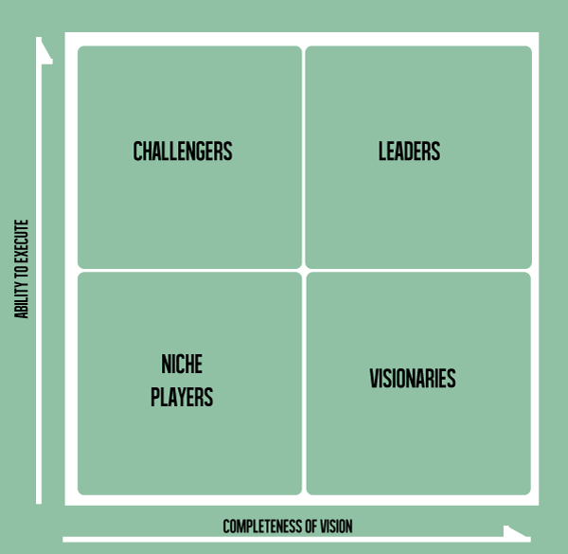
Building your market research toolkit

Slide 38
Building your market research toolkit
The Magic Quadrant is a tool used to plot points across different axis.
In this case, Gartner uses it to plot where different companies fall for any given category (e.g. space exploration, software development, human centered design).

Slide 39
Building your market research toolkit
Using a tool like this can help you further segment the market and make market research more efficient.
GSA used the Gartner Magic Quadrant while conducting market research in support of the Salesforce BPA; it was the market research phase that helped GSA understand the need and ultimately drove the technology solution they selected.

